Slide 1
Infrastructure costing
by technology
AILA CRM · READY-TO-SALE V1
Azure Server × 2 · Kubernetes · Docker · Kafka · SQL Server · Load Balancer · .NET 10 · Angular
Indicative monthly costs · Azure Southeast Asia · live list prices, 2 October 2026
Notes:
An idea of infrastructure cost for the client. Prices pulled live from the Azure Retail Prices API for Southeast Asia (Singapore), the closest Azure region to Bangladesh.

Slide 2
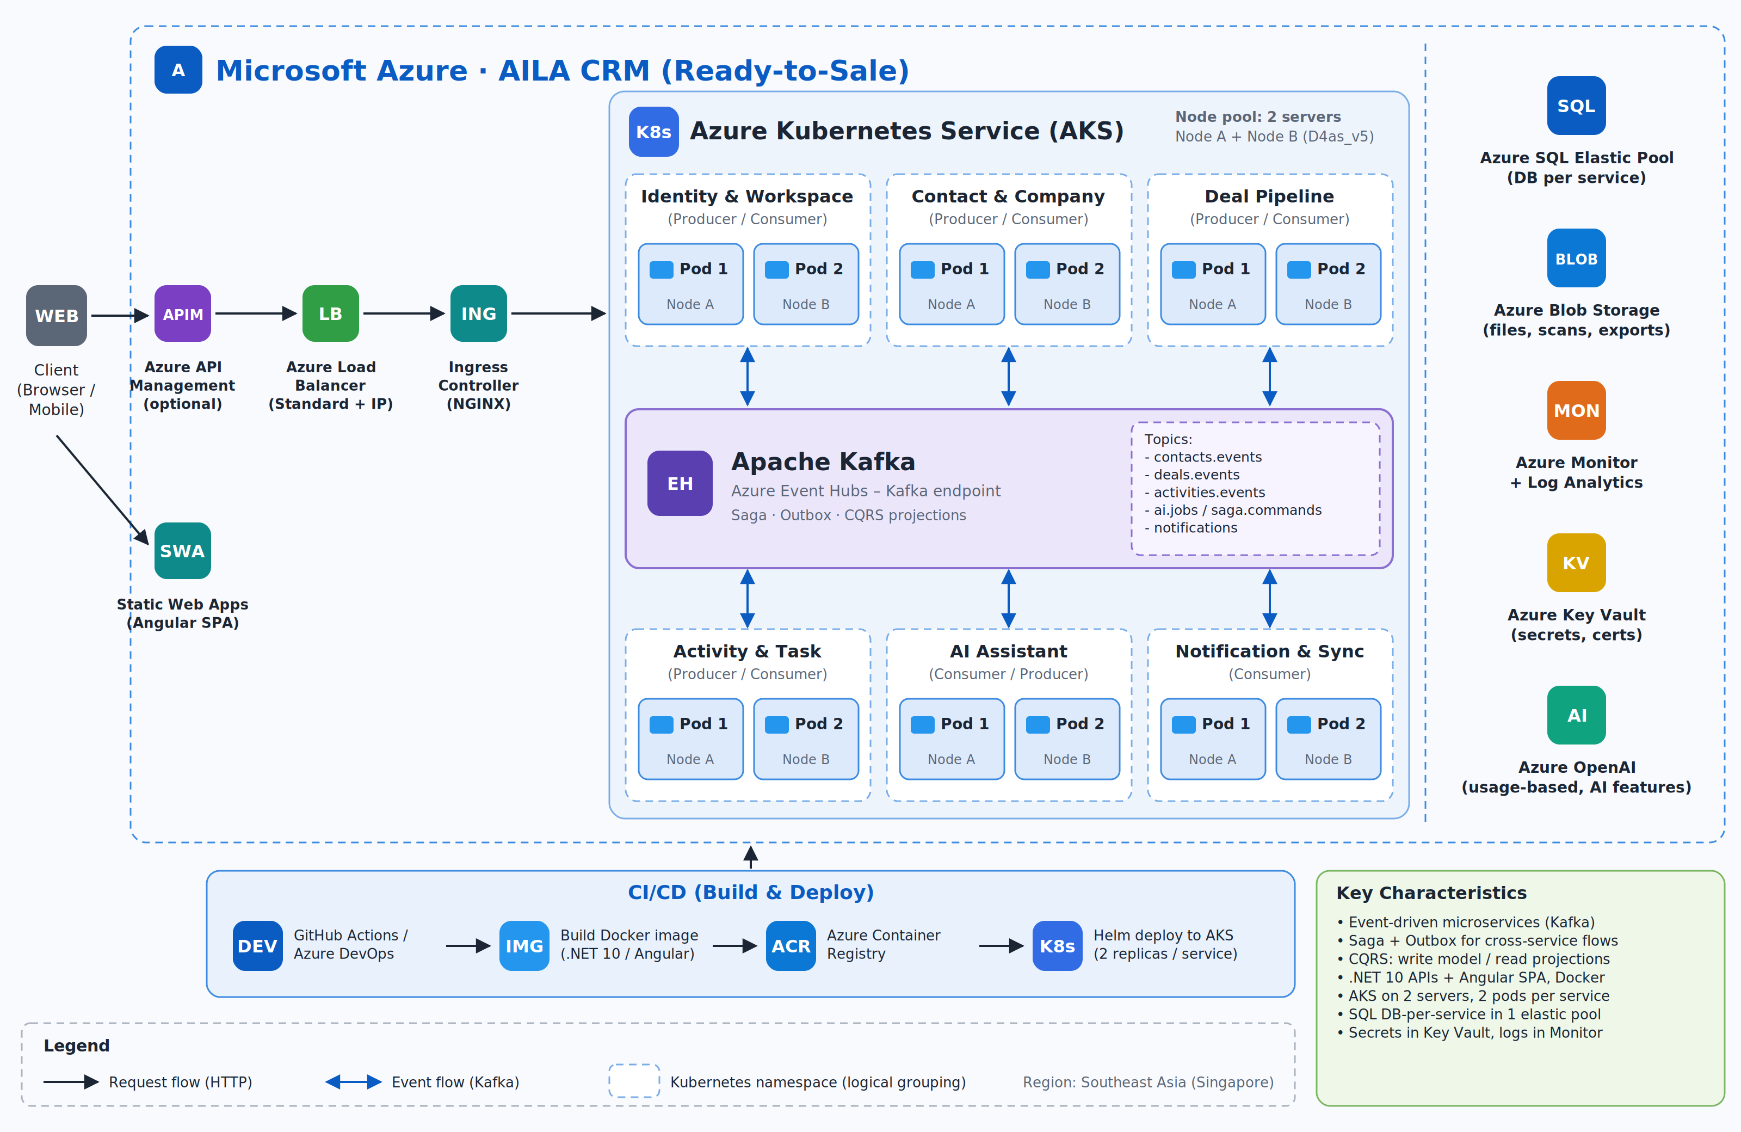
How the pieces fit
INFRASTRUCTURE ARCHITECTURE DIAGRAM
Client → Load Balancer → Ingress → AKS (2 servers)

Slide 3
Azure Server × 2
TECHNOLOGY 1 OF 8
2 × D4as_v5 Linux (4 vCPU · 16 GB RAM) + 128 GB SSD disk each — the two AKS worker nodes
Options compared (monthly)
Option | Monthly
B4ms burstable (4 vCPU/16 GB) | $308.06
D4as_v5 AMD (4 vCPU/16 GB) ★ | $315.36
D4s_v5 Intel (4 vCPU/16 GB) | $350.40
D4as_v5 · 1-year reserved | $194.50
D4as_v5 · 3-year reserved | $124.56
$334.56
/month for both servers
Price for 2 servers, compute only. OS disks (2 × Standard SSD E10) add $19.20/month and are included in the big number.
★ = recommended · Live list prices: Azure Retail Prices API · Southeast Asia (Singapore) · USD · 2 Oct 2026 · 730 h/month

Slide 4
Kubernetes (AKS)
TECHNOLOGY 2 OF 8
Azure Kubernetes Service control plane managing the 2 servers. Nodes are billed under ‘Azure Server’.
Options compared (monthly)
Option | Monthly
Free tier (no uptime SLA) | $0.00
Standard tier (99.9% SLA) ★ | $73.00
Automatic tier (hosted control plane) | $116.80
$73.00
/month · Standard tier
Start staging/dev on the Free tier; use Standard for production.
★ = recommended · Live list prices: Azure Retail Prices API · Southeast Asia (Singapore) · USD · 2 Oct 2026 · 730 h/month

Slide 5
Docker
TECHNOLOGY 3 OF 8
Docker images for every service. Container runtime on AKS is free; images are stored in Azure Container Registry.
Options compared (monthly)
Option | Monthly
Docker runtime on AKS (containerd) | $0.00
ACR Basic · 10 GB included ★ | $5.07
ACR Standard · 100 GB included | $20.28
Extra image storage | $0.10 / GB
$5.07
/month · ACR Basic
Docker Desktop licences for developers are not part of infrastructure cost.
★ = recommended · Live list prices: Azure Retail Prices API · Southeast Asia (Singapore) · USD · 2 Oct 2026 · 730 h/month

Slide 6
Kafka
TECHNOLOGY 4 OF 8
Managed Kafka endpoint on Azure Event Hubs Standard, 2 throughput units (≈ 2 MB/s in, 4 MB/s out).
Options compared (monthly)
Option | Monthly
Self-hosted Kafka on the 2 servers (disk only) | $19.71
Event Hubs Standard · 2 TU + Kafka endpoint ★ | $109.78
↳ throughput units 2 × $21.90 | $43.80
↳ Kafka endpoint | $65.70
Event Hubs Premium · 1 PU | $975.28
$109.78
/month · Event Hubs Standard
Ingress events add $0.028 per million (≈ $0.28 for 10M). Self-hosting is cheapest but uses server RAM and has no high availability on 2 servers.
★ = recommended · Live list prices: Azure Retail Prices API · Southeast Asia (Singapore) · USD · 2 Oct 2026 · 730 h/month

Slide 7
SQL Server
TECHNOLOGY 5 OF 8
Azure SQL Database (SQL Server engine), one database per microservice, sharing a Standard elastic pool.
Options compared (monthly)
Option | Monthly
4 × single DB S0 (10 DTU each) | $58.87
Elastic pool Standard 50 eDTU, 50 GB ★ | $110.26
4 × single DB S1 (20 DTU each) | $117.73
Elastic pool Standard 100 eDTU | $220.52
$110.26
/month · elastic pool 50 eDTU
Backups, patching and high availability are included. Up to 100 databases fit in one pool.
★ = recommended · Live list prices: Azure Retail Prices API · Southeast Asia (Singapore) · USD · 2 Oct 2026 · 730 h/month

Slide 8
Load Balancer
TECHNOLOGY 6 OF 8
Azure Standard Load Balancer with one static public IP in front of the AKS ingress controller.
Options compared (monthly)
Option | Monthly
Standard LB · first 5 rules | $18.25
Data processed · ~100 GB × $0.005 | $0.50
Static public IP (Standard) | $3.65
Total ★ | $22.40
$22.40
/month · Standard LB + IP
Extra rules above 5 cost $0.01/hour each ($7.30/month).
★ = recommended · Live list prices: Azure Retail Prices API · Southeast Asia (Singapore) · USD · 2 Oct 2026 · 730 h/month

Slide 9
.NET 10
TECHNOLOGY 7 OF 8
Backend microservices in .NET 10 (ASP.NET Core) running in Linux containers.
Options compared (monthly)
Option | Monthly
.NET 10 runtime & SDK | $0.00
Linux container hosting (no licence) ★ | $0.00
Same server on Windows instead (each) | +$134.32
$0
/month · free and open source
Running .NET on Linux avoids Windows licence cost: D4as_v5 Windows is $0.40/h vs $0.216/h Linux.
★ = recommended · Live list prices: Azure Retail Prices API · Southeast Asia (Singapore) · USD · 2 Oct 2026 · 730 h/month

Slide 10
Angular
TECHNOLOGY 8 OF 8
Angular front-end (latest) built to static files and hosted on Azure Static Web Apps.
Options compared (monthly)
Option | Monthly
Angular framework | $0.00
Static Web Apps Free (no SLA, hobby) | $0.00
Static Web Apps Standard · custom domain + SLA ★ | $9.00
Serve from an AKS pod instead | $0.00 extra
$9.00
/month · Static Web Apps Standard
Static Web Apps Standard price from Microsoft’s published plan (per app).
★ = recommended · Live list prices: Azure Retail Prices API · Southeast Asia (Singapore) · USD · 2 Oct 2026 · 730 h/month

Slide 11
Total infrastructure cost per month
SUMMARY
Technology (recommended setup) | Monthly
Azure Server × 2 | $334.56
Kubernetes (AKS) | $73.00
Docker | $5.07
Kafka | $109.78
SQL Server | $110.26
Load Balancer | $22.40
.NET 10 | $0.00
Angular | $9.00
Total per month | $664.07
Recommended, pay-as-you-go
$664.07
$7,968.84 per year
With 1-year reserved servers
$543.21
$6,518.52 per year
Economy setup (next slide)
$433.31
Not included: monitoring, Key Vault, blob storage, API Management, AI usage, bandwidth over 100 GB — typically +$30–60/month at launch.

Slide 12
Economy setup: lowest possible start
COMPARISON
Technology | Economy choice | Monthly
Azure Server × 2 | 2 × B4ms + disks | $327.26
Kubernetes (AKS) | Free tier | $0.00
Docker | ACR Basic | $5.07
Kafka | Self-hosted on servers | $19.71
SQL Server | 4 × S0 | $58.87
Load Balancer | Standard + IP | $22.40
.NET 10 | Linux | $0.00
Angular | SWA Free | $0.00
Total |  | $433.31
Trade-offs
Saves $230.76/month, but: no Kubernetes uptime SLA, Kafka runs on our own servers without failover, burstable CPU, and small databases. Good for pilot / demo customers only.
Live list prices: Azure Retail Prices API · Southeast Asia (Singapore) · USD · 2 Oct 2026 · 730 h/month

Slide 13
Launch on the recommended setup at about $664.07/month, then reserve the servers
RECOMMENDATION
Use the economy setup only for staging / demo
Buy a 1-year server reservation after 60–90 days → about $543.21/month
Add a 3rd server (+$167.28/month) when usage grows
Prices are indicative; final quote from the Azure Pricing Calculator

